Slide 1

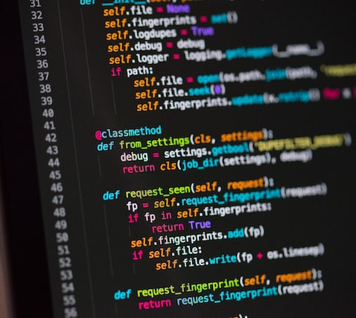
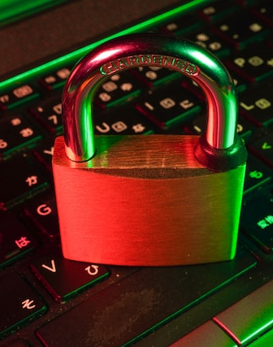

Secure Password Generator
Team Members: Xavier Scott
Main concept: This application will generate secure passwords for users that contain a mix of characters and meet password length requirements. Users will have the option to generate as many passwords as they wish.

